Slide 1
Real Time Scheduling
Common Approaches to Real Time Scheduling:
Clock driven approach
Weighted Round – Robin approach
Priority Driven approach

Slide 2
Approaches in RTS
Three major approaches in designing pre-emptive scheduling algorithms for real time tasks:
Clock driven approach
Weighted Round – Robin approach
Priority Driven approach

Slide 3
Clock-Driven Scheduling
It uses a stored schedule and makes decisions at specified times.
Offline generated schedule
Use timer interrupt online
Low overhead

Slide 4
Assumptions:
There are n periodic tasks in the system. n is fixed.
The parameters of all periodic tasks are known a priori. In particular, each job in T_{i} is released p_{i} units of time after the previous job in T_{i} .
The phase of each periodic task is a non negative multiple of the frame size i.e. every job is released at the beginning of one of the frames.
Each job J_{i,k} is ready for execution at its release time r_{i,k} .
There is no preemption with in a frame.
We focus on scheduling tasks on one processor
There are no sporadic jobs but a periodic jobs may exists & can be released at unexpected times.

Slide 5
Notations:
A periodic task T_{i} with phase φ_{i} , period p_{i} , execution time e_{i} , and relative deadline D_{i} by the 4-tuple (φ_{i} , p_{i} , e_{i} , D_{i} )
ex- (1, 10, 3, 6) is a periodic task whose
phase is 1, period is 10, execution time is 3, and relative deadline is 6. Therefore the first job in this task is released and ready at time 1 and must be completed by time 7;
the second job is ready at 11 and must be completed by 17, and so on.
Each of these jobs executes for at most 3 units of time.
The utilization of this task is 0.3

Slide 6
Disadvantages:
1)Require fair amount of memory to store scheduling table.
2)Slight change in task parameter(time) require a complete change of scheduling table.
3)Not adaptive to any change at run time.

Slide 7
Round-Robin Scheduling
It assigns one time slice to a job at a time..
Weighted RR assigns slots based on weights.
Good for job pipelining, bad for precedence in general.

Slide 8
WRR approach is to assign a fraction of processor to each task, depending on utilization factor.
Since a processor cannot be use by more than one task at the same time , processor sharing is approximated by dividing time interval into smaller time slices.

Slide 9
Priority Driven Scheduling
Each task is assigned priority.
At run time, ready task that has the highest priority will receive the processor for execution.
Priorities can be assigned at run time(Dynamic Priority) or fixed at the beginning(Static or fixed).

Slide 10
Also referred to as greedy scheduling, list scheduling
and work-conserving scheduling.
A priority-driven algorithm is greedy because it tries to
make locally optimal decisions. Leaving a resource idle while some job is ready to use the resource is not locally optimal.

Slide 11
Priority Driven Scheduling
This approach is greedy and decides based on events.
If possible, never leaves the resource idle (locally optimal).
Uses a priority queue (=list)
Static vs dynamic priority assignment
Many different forms of assigning priorities

Slide 12
Eg:
Task graph shown here is a classical precedence graph
All its edges represent precedence constraints. The number next to the name of each job is its execution time.

Slide 13
All the other jobs are released at time 0.
We want to schedule and execute the jobs on two processors P1 and P2.
They communicate via a shared memory.
Ji has a higher priority than Jk if i < k.
At time 0, jobs J1, J2, and J7 are ready for execution.
Since J1 and J2 have higher priorities than J7, they are ahead of J7 in the queue and hence are scheduled.

Slide 14
Time | Job
At time 0 At time 1 | J1,j2,j7 J3
At time 3 | J4
At time 4 | J5
At time 5 | -
At time 6 | -
At time 8 | J6,j8

Slide 15
At time 1, J2 completes and, hence, J3 becomes ready. J3 is placed in the priority queue ahead of J7 and is scheduled on P2, the processor freed by J2.
At time 3, both J1 and J3 complete. J5 is still not released. J4 and J7 are scheduled.
At time 4, J5 is released. Now there are three ready jobs. J7 has the lowest priority among them. Consequently, it is preempted. J4 and J5 have the processors.
At time 5, J4 completes. J7 resumes on processor P1.
At time 6, J5 completes. Because J7 is not yet completed, both J6 and J8 are not ready for execution. Consequently, processor P2 becomes idle.
J7 finally completes at time 8. J6 and J8 can now be scheduled and they are.

Slide 16
Priority Driven Scheduling Example
Is this the best we can do?

Slide 17
Time | Job
At time 0 At time 1 | J1,j2,j7 J3
At time 3 | J4
At time 4 | J5
At time 5 | -
At time 6 | -
At time 7 | J6,j8

Slide 18
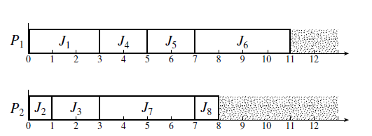

Slide 19
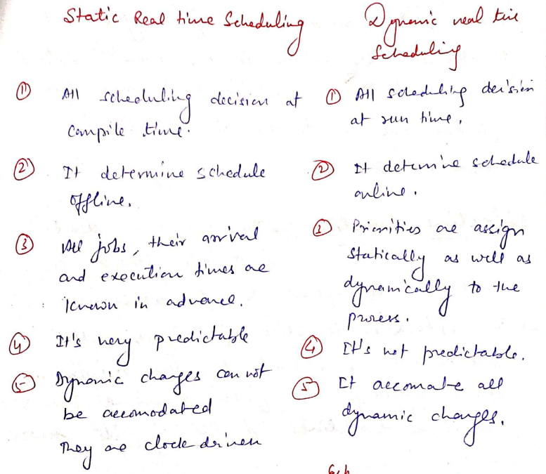

Slide 20
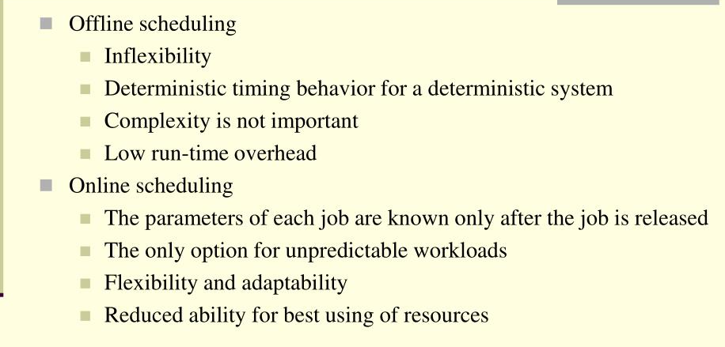

Slide 21
